Slide 1
Student Records Collection
Washington County Schools
Spring 2015-2016 Workshop

Slide 2
Suggestions
Please use this forum for expressing your suggestions
We can all learn from each other to make our jobs easier and more efficient
Running list of Suggestions
Tips & Tricks

Slide 3
Compiling Data
Who is responsible for providing each data element?
Who will enter each data element?
A school-specific deadline for data entry should be set.
Who will verify the data for each element?
Those who enter the data should be responsible for the accuracy.

Slide 4
Resources
Data Elements for Student record Collection
Student Records Collection Checklists
VDOE SRC website
http://www.doe.virginia.gov/info_management/data_collection/student_record_collection/index.shtml
Information Systems
Jennifer Rhea (jrhea, x3061)
Lisa Okes (lokes, x3065)

Slide 5
Share Information
Data definitions
Codes
Deadlines for data
PowerSchool Tips & Tricks - http://wiki.wcs.k12.va.us/powerschool/powerschool/tipsandtricks
Student Searches
http://wiki.wcs.k12.va.us/powerschool/powerschool/studentsearches
Quick export provides sortable lists within MS Excel

Slide 6
Reminders
Transfers / Early Graduates / HMB
All Inactive students (even no-shows) MUST have complete enrollment records
Exit date
Exit code
New Enrollments
Update all codes at time of enrollment

Slide 7
Reminders, cont.
Next School and Next Grade
These fields need to be populated continuously as new students are enrolled / transferred
Confirm before scheduling following year
Use Group Function for setting Next School Indicator

Slide 8
Updated Codes
New Codes…
Military Connected Student Code
PK Funding Source
Virtual Virginia Tuition Paid Code
Retired Codes, but still in use…
Foster Care (SpEd use)
Retention (EOY use)

Slide 9
Military Connected Student Code
Search using /S_VA_STU_X.Military_Connected= ; EntryDate >= 8/10/2015
Correct those with Military Connected Student Code Flag equals blank
Enrollment > Transfer Info > Edit Current Enrollment

Slide 10
PK Funding Source Code (ES - PK Only)
Remove PK Funding for older students
Correct blank PK Funding fields by searching for /S_VA_STU_X.PK_Funding_Source= ;Grade_level=-1;schoolID#1;EntryDate >= 8/10/2015
Enrollment > Transfer Info > Edit Current Enrollment
Confirm any changes with Amanda Yarber’s staff

Slide 11
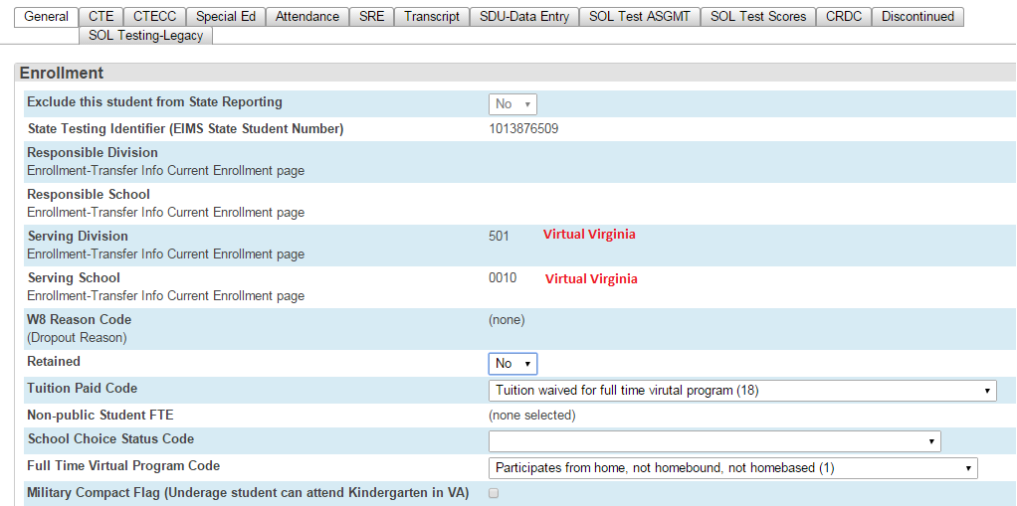
Virtual Virginia Tuition Paid Code
Listed as Full Time Virtual Program Code on data_elementsSpr15-16.pdf and Spring Checklist
MUST be enrolled Full Time as Virtual Virginia student

Slide 12
Search Tips Notes
State Testing Identifier (STI)
All students MUST have an STI
Contact Karen Gilbert (x3066) for assistance
Responsible Division Number
All VA residents must have a responsible district of Washington County Public Schools (094) – leave this field blank
All out of state students must have a responsible district of Public School Outside of Virginia (888)

Slide 13
Search Tips Notes, cont.
Responsible School Number
All VA residents must have a responsible school equal to your school number – leave this field blank
If a blank value does not default to your school number, enter your school number
School numbers are located on the StateSchoolNumbers tab of the PS Search Tips SRC_SPR
All TN students should have a responsible school of 0047

Slide 14
Search Tips Notes, cont.
Serving Division/School Number
Majority of all students should have the same serving division/school as their responsible division/school – Leave this field blank
Exceptions:
Homebound (094/9998) / Homebased (094/9999) students
APS (094/8888); Virtual Virginia (501/0010)
AHS/GES Special Education classrooms being funded through Cooperative Centers for Exceptional Children (280/0010)
LHGS, Governor’s School (268/0010)
OOD Special Education students that are attending Interchange, or residential facilities and for whom we are responsible (600/8000)

Slide 15
Search Tips Notes, cont.
Active Status Code
Students who are in membership should have an active status
If you get a list of students after running the search /Enroll_Status > 3, contact Information Systems.
Students who have been pre-registered for next year MUST have an enroll_status of -1 (pre-registered).

Slide 16
Search Tips Notes, cont.
Entry Code
All students MUST have an entry code
Entry Date
All students MUST have an entry date on or after the first day of the school year

Slide 17
Search Tips Notes, cont.
Exit Code
Students with an exit date prior to end of school year MUST have an exit code
Exit Date
Student with an exit dates before the first day of the school year must be changed to the first day of the school year to indicate a No-Show

Slide 18
Search Tips Notes, cont.
Gender Code
No student should have a blank Gender code. This is a required field.
Run list of males and check for errors, then do the same for females
Birth Date
No student should have a blank birth date. This is a required field.
Check minimum birth date for school level
Check for current year in birth date

Slide 19
Search Tips Notes, cont.
Grade Level Code
If student’s grade level is KG, then students grade level code field under VA State Information MUST also be KG
If student’s grade level is PK, then students grade level code field under VA State Information MUST also be PK
Located under the Virginia State Information section of Transfer Info page
Primary Disability Code
Special Ed Only

Slide 20
Search Tips Notes, cont.
Economically Disadv. Status Flag
Work with nurses to flag students receiving Medicaid or FAMIS
Flag is set by SIS Technicians after insurance input is completed
Home Language Code
Search for students with a home language not equal to blank, then verify
English is the default. If the Home Language is not English, the language code is required when the Receiving ESL Services Code (VA_LEP_Serv_Code) is NOT blank

Slide 21
Search Tips Notes, cont.
Title I Code
Only for Title I Targeted Assistance Schools
AES, GES, HPES, MES, WES
Grades PK-2nd
Codes 01 or 03
GED Program Code (HS Only)
All students currently enrolled in a GED or the ISAEP program must be flagged
Typically, no student should be marked GAD (3)

Slide 22
Search Tips Notes, cont.
Graduate/Other Completer Code and Graduation Plan Code
Students who graduate before Spring SRC deadline (March 31st) MUST be flagged
All others can be marked
IS Department will search for all students with an exit date on the extract and remove flag for all others (NOT done in PS)

Slide 23
Search Tips Notes, cont.
W8 Reason Code
All students who have a W880 must be flagged with a W8 Reason Code
If student returns, adjust Exit Code and remove W8 Reason Code
Aggregate Days Present /Absent
Work with Attendance Clerk
Run ADA/ADM by Student report
Look for duplicate students
Membership total should always be more than Attendance total or Absence total

Slide 24
Search Tips Notes, cont.
Tuition Paid Code
Governors School students = 04
AHS/GES Special Ed Program students = 04
TN students = 10
All others should be blank for now!
Non-public student FTE – VERY IMPORTANT
All students receiving speech services only = 10
Part-time students taking one course approved for SOQ (Standards of Quality) = 25
This may include GED grads finishing CTE program
Part-time students taking two courses approved for SOQ = 50
This may include GED grads finishing CTE program

Slide 25
Search Tips Notes, cont.
KG Readiness Assessment Flag
If a student turns five (5) after October 1 of the current year, they MUST be flagged.
Early College Scholar Prog. Code
Student should only be flagged as signing the agreement (1) on the Spring SRC
However,VA Transcript then shows “No”

Slide 26
Search Tips Notes, cont.
PK Experience Code
PK and KG students must be flagged
PK reflects current classroom setting
KG reflects previous experience
If student is in PK then PK Exp Code cannot be 50, 51, or 60
PK Weekly Time Code
PK and KG students must be flagged
Code = 0 can only be used for KG students with PK Exp. Code of 50, 51, or 60

Slide 27
Search Tips Notes, cont.
Initial Primary Nighttime Residence Code
Work with Karen Petterson in Special Services
Full time Virtual Program Code
99.9% of the time the Virtual Virginia Tuition Paid Code should not be selected

Slide 28
Search Tips Notes, cont.
Ethnic Flag/Race Code
No student should be marked as Unspecified
If parent refuses to classify students race, the principal must determine code.
Ethnic flag identifies student as Hispanic/Latino.
Race can be one or more races with which the student identifies himself/herself.
Receiving ESL Services Code
Judy Honaker, Coord. of Math and Testing, is handling this now.
Unaccompanied Homeless Youth Flag
Make sure NO students are flagged.

Slide 29
Search Tips Notes, cont.
Codes for other departments:
First Semester Special Ed Regional Tuition Reimbursement
Special Ed Regional Tuition Reimb Disability Code
MOP Flag
MOP Number of Classes
Resident Division

Slide 30
Search Tips Notes, cont.
Military Compact Statute Flag
To be used to indicate an underage student can attend KG in VA
Credit Accommodation Flag
A flag used to indicate a student used credit accommodations as outlined in their IEP to obtain a Standard Diploma.
Guidance needs to work with Special Services Department.
Military Connected Students Code
Survey parents for information

Slide 31
Search Tips Notes, cont.
PK Funding Source Code
Work with Amanda Yarber’s staff for confirmation
First/Middle/Last Name
All must have legal name
Use quick export to get a sortable list

Slide 32
SRC Data Verification
Use Student Records Collection Worksheet (a.k.a. Search Tips), to run the searches for each of the data elements and analyze the results.
Run the Search Tips again & again
What should you expect to see?

Slide 33
More Reminders
Once pre-registration begins, search using /Enroll_Status # -1;EntryDate >= <CURRENT DATE>;EntryDate <= 8/10/2016
This search will list all students enrolled from current date to beginning of next school year.

Slide 34
More Reminders, cont.
Search students enrolled on current date to determine of the student(s) should be pre-registered or have a status of active.
If status of active is correct, no further action is required.
If the student should have been pre-registered, contact Information Systems to change their status.

Slide 35
More Reminders, cont.
Private school students enrolled for Summer SOL purposes
Any private school student who needs to be enrolled ONLY to take SOL's during the summer may be pre-registered after the month of March (into the next school year). DO NOT enroll these students in the current school year as they should NOT be counted in current year ADM.

Slide 36
More Reminders, cont.
KG Registration Day
The new school year is setup now to accommodate KG registration day. The official start date of the new school year has been announced.
List student ages
Add the data access tag of ^(age) to any Quick Export to get a list of students by age. If you need further assistance, please contact Information Systems.

Slide 37
More Reminders, cont.
Disadvantage Status Flag
For reporting purposes, we have updated PS to allow those in the counselor group to see a student’s disadvantaged status

Slide 38
Report Cards / Transcripts
School Announcements
Meeting attendance on HS Report Cards
Report Card with Early Dismissal
Transcripts on Shared P: drive
VA Transcripts with CTE and Verified Credits
Yearly attendance on VA Transcripts

Slide 39
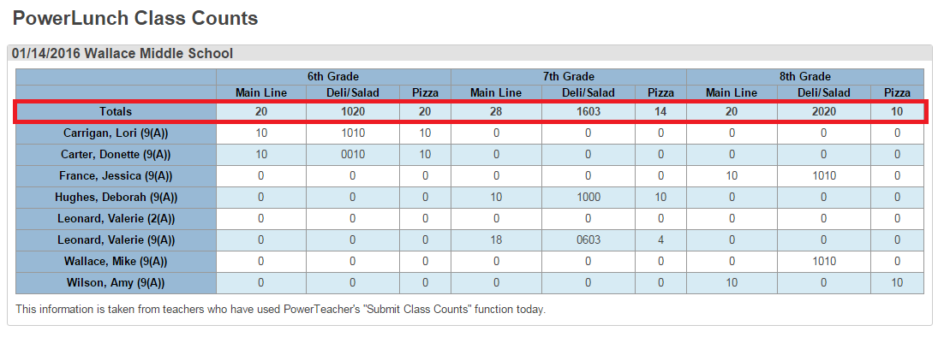
PowerLunch
Middle Schools have started using PowerTeacher / PowerSchool to calculate the Lunch Count

Slide 40
PowerTeacher for Subs
Who is training the substitutes to use PowerTeacher?
Who knows the password?
They can record Attendance and Lunch Counts
Need computer access in the classrooms

Slide 41
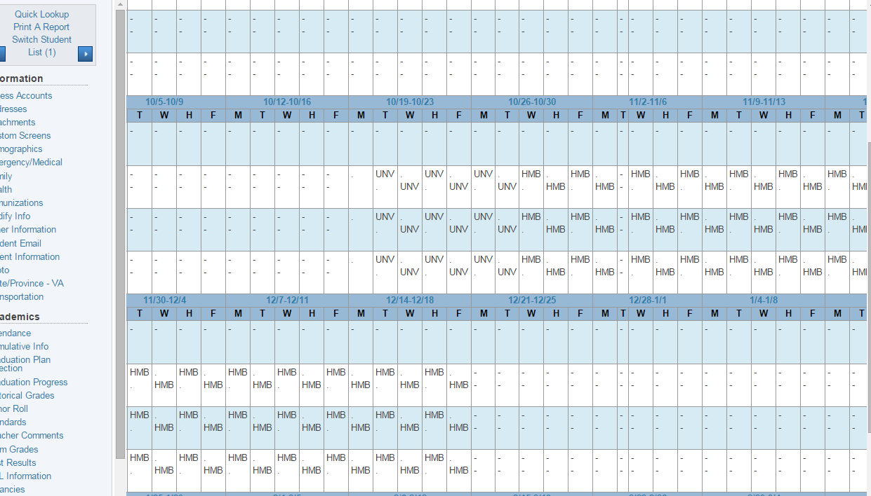
Homebound / Homebased
Search for all HMB attendance
Create new enrollments each time a student is moved in/out of these services
Confirm with attendance to ensure the dates are recorded correctly
Confirm dates with the formal documentation
When is the Exit date?

Slide 42
Attachments
Each student has an Attachments page
Be aware of the security levels for this page
How would your schools use this new feature?

Slide 43
Back to the Checklist
Person responsible for entering particular data must initial on the line to the right of each element.
Check each bullet to the left of each element as you verify that it is complete and accurate as of snapshot date.
Run the Search Tips once again
Sign
Have principal sign
Return by due date via school mail only

Slide 44
Stay tuned…
Look for more emails
New Search Tips
Updates
SRC Errors
Document changes
Data changes
New information
Verification needs
Final reports

Slide 45
Thank You…
Any Questions?

Slide 46
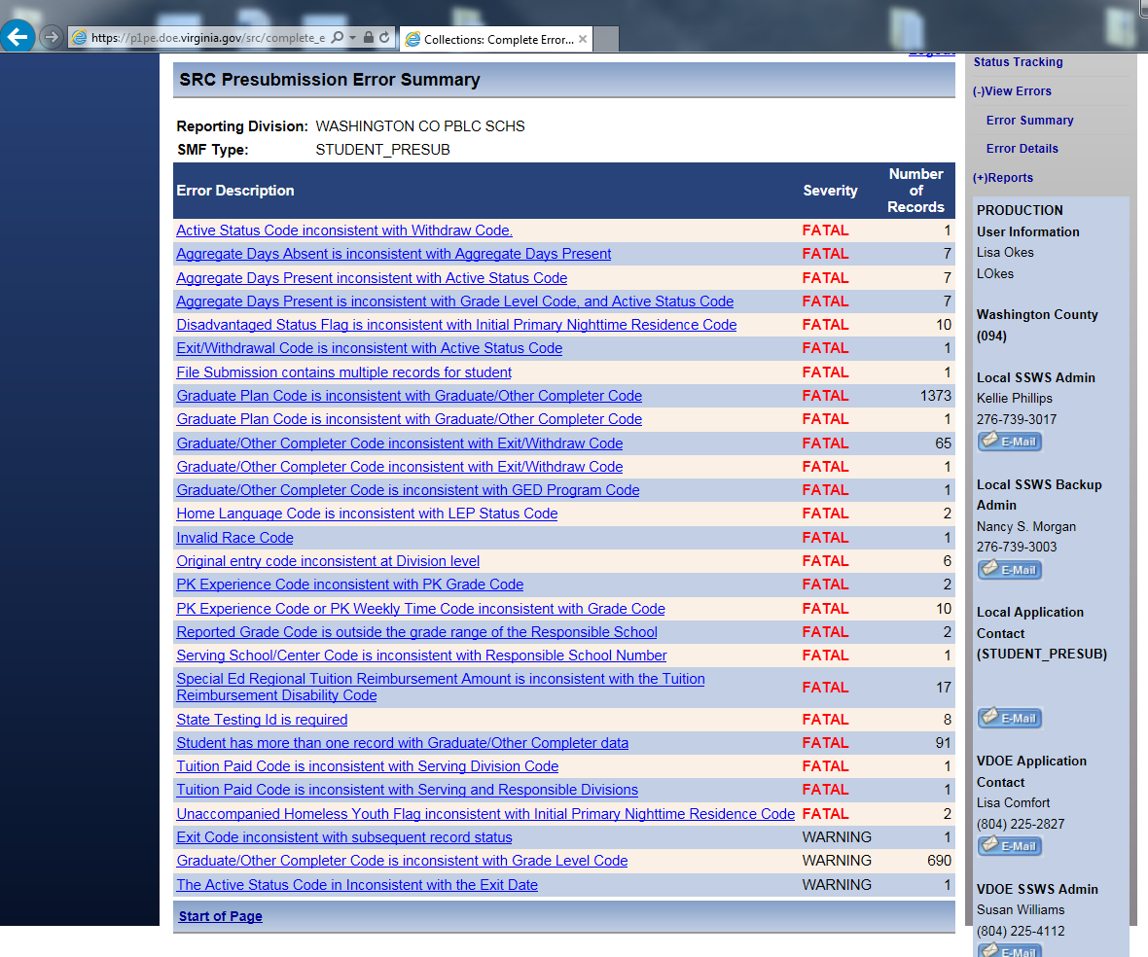
Let’s get started!
Presububmission generated 1619 errors

